Slide 1
T H E C O M P L ET E W O R L D O F E D U C A T I O N
Recognised under the senion 2 (g of the UGC Act 1956
) the Youth; Empowering the Nation

Slide 2


Secure Web based Voting System using face authentication
Pre Final Year Project Synopsis
Submitted by
ROLL | NAME
2301010047 | Ankit Patel
2301010030 | Shami Ahmad
2301010027 | Aaditya
2301010039 | Akshat Kumar Singh
Faculty Mentor: Dr. Shweta Bansal

Slide 3

Project Overview
Brief Overview of the Topic:
The Secure Web-Based Voting System allows voters to cast their votes online in a secure manner.
The system uses face authentication to verify the identity of voters.
It ensures transparency, security, and accessibility for voters, especially NRIs.
it eliminates the need for physical polling stations and reduces manual effort.

Slide 4
About the Problem
Problems Identified
Inaccessibility: NRIs and remote voters cannot reach polling stations.
Security Issues: Traditional systems are prone to impersonation and duplicate voting.
High Cost: Physical elections require manpower, logistics, and paper ballots.
Low Voter Turnout: Travel constraints and long queues discourage voting.
Slow Vote Counting Process: Manual tallying of votes leads to delays in announcing election results.

Slide 5
Problem Statement
Clearly Define the Problem
Traditional voting systems require physical presence and lack strong authentication mechanisms, making them inaccessible for NRIs and vulnerable to fraud such as impersonation and duplicate voting.
Why is it Important?
Enables remote and secure voting.
Prevents fraudulent voting using biometric authentication.
Improves participation and trust in the electoral process.
Expected Impact
Higher voter turnout due to ease of access. Secure and tamper-proof voting process.
Faster and more accurate election results.

Slide 6
Objectives
Develop a secure and user-friendly Secure voting system accessible to all eligible voters.
Ensure vote encryption and data integrity using blockchain or cryptographic techniques.
Provide real-time vote counting and immediate result generation.
Minimize the risk of election fraud and unauthorized access.

Slide 7
Methodology, Tools, and Techniques
Approach taken to solve the problem
User Registration: Voter registers with Aadhaar details and face data.
Face Authentication: Live face verification during voting.
Voting Process: Vote allowed only after successful authentication.
Security: Voting status updated to prevent duplicate voting.
Result Processing: Automated vote counting.
Tools & Technologies Used:
Frontend: HTML,CSS,JavaScript
Backend: Python, Flask
Database: SQLite/MySQL
Face Recognition: OpenCV
Visualization: Chart.js

Slide 8

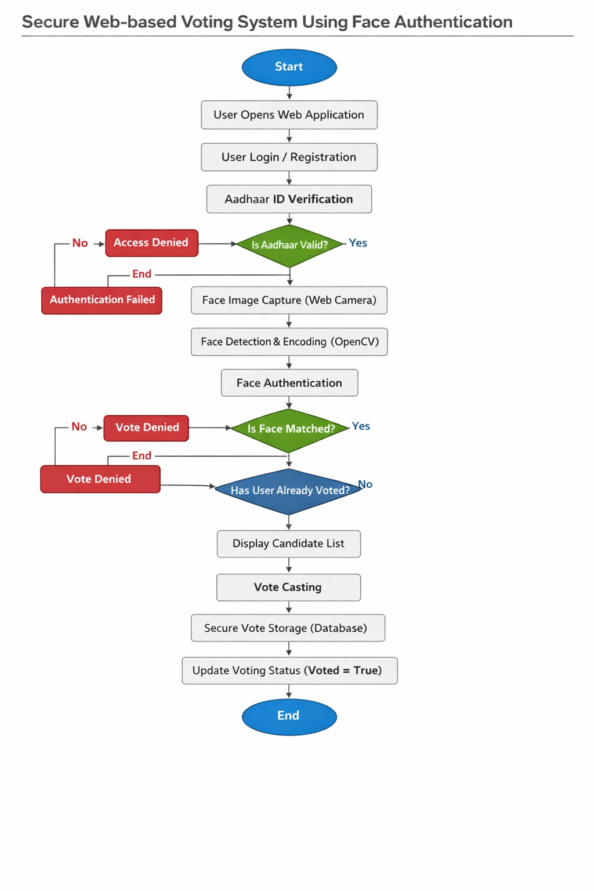
Methodology Flowchart

Slide 9
Expected Results & Impact
Expected Results:
Fully functional secure web Based voting system with high security and reliability.
Real-time vote counting and instant result generation.
A prototype system that can be tested for scalability and
usability
Impact:
For Governments & Organizations:
Reduces the cost and time associated with elections.
For Voters:
Provides an easy, accessible, and secure way to cast votes from
any location.
Encourages higher voter participation.
Future Scope:
Implementation of AI-powered fraud detection.
Expansion for global elections and referendums.

Slide 10
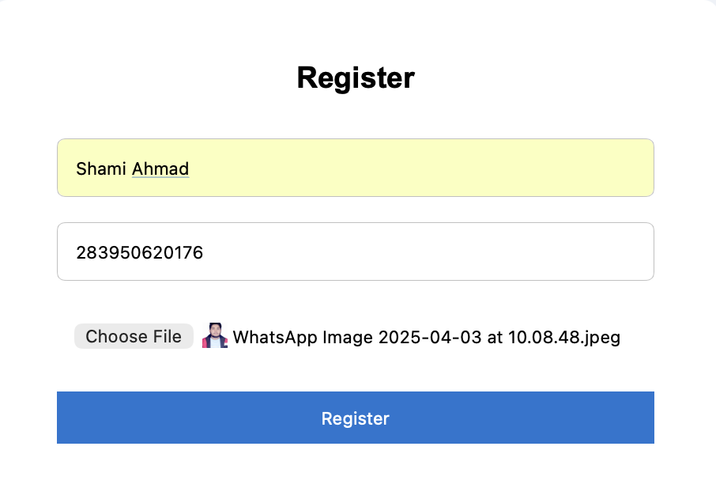
Project Result for Voter Registration

Slide 11
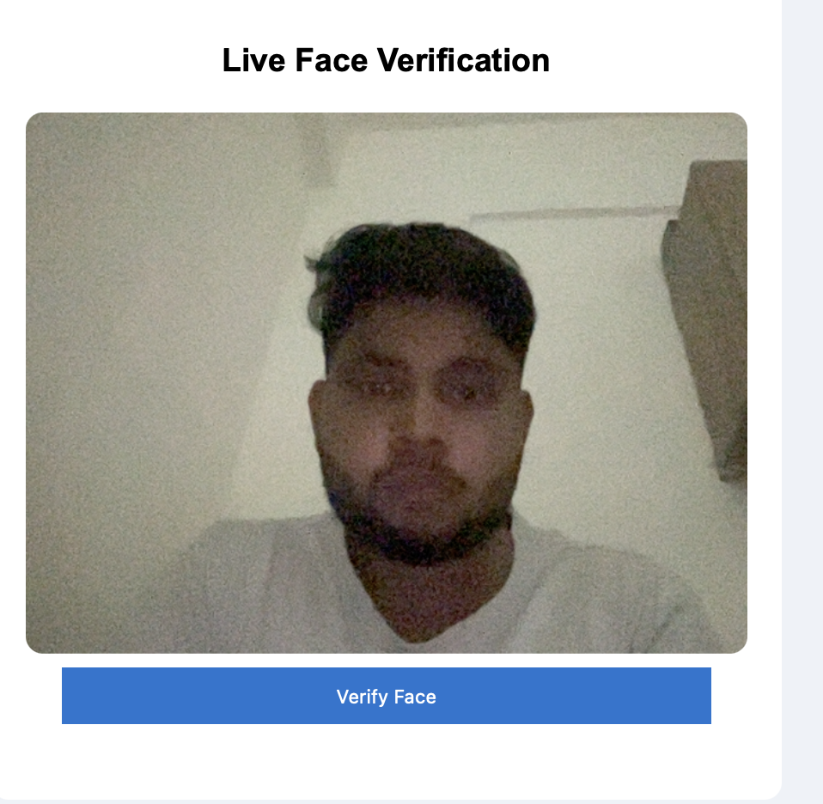
Press ‘S’ for voter Face verification

Slide 12
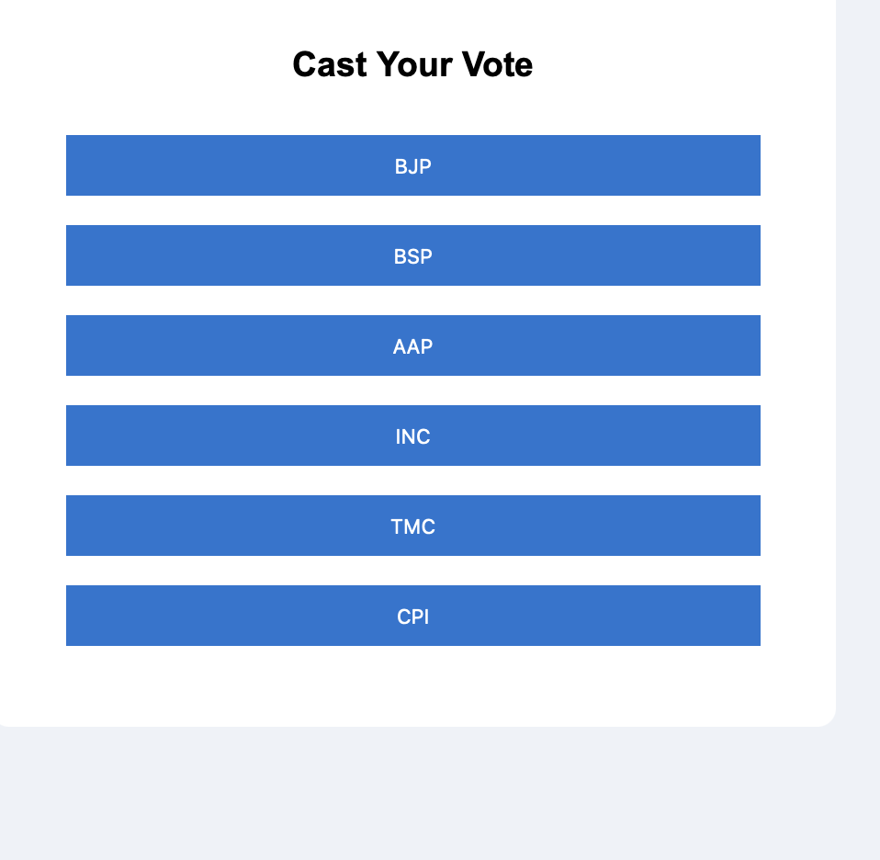
After Authentication then Cast Vote

Slide 13
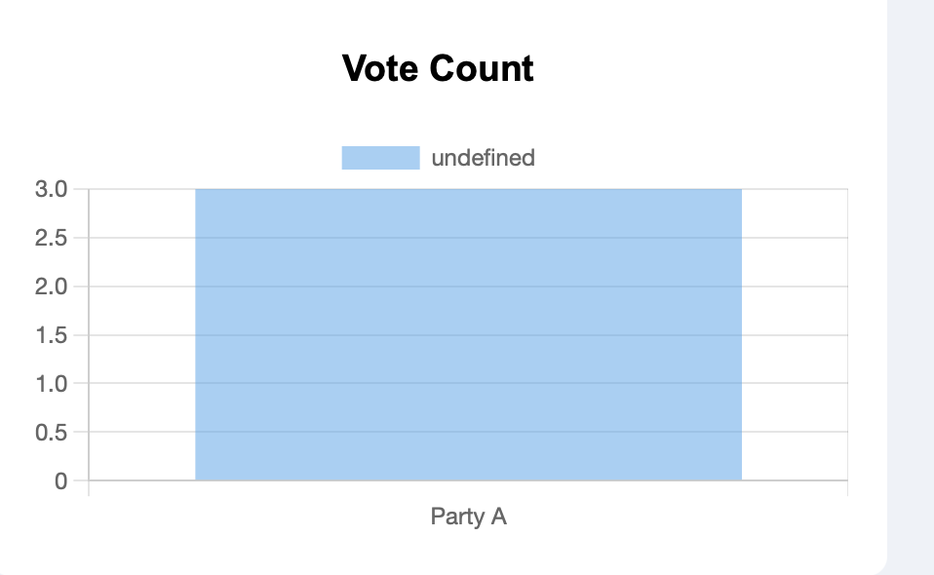
Vote submition

Slide 14
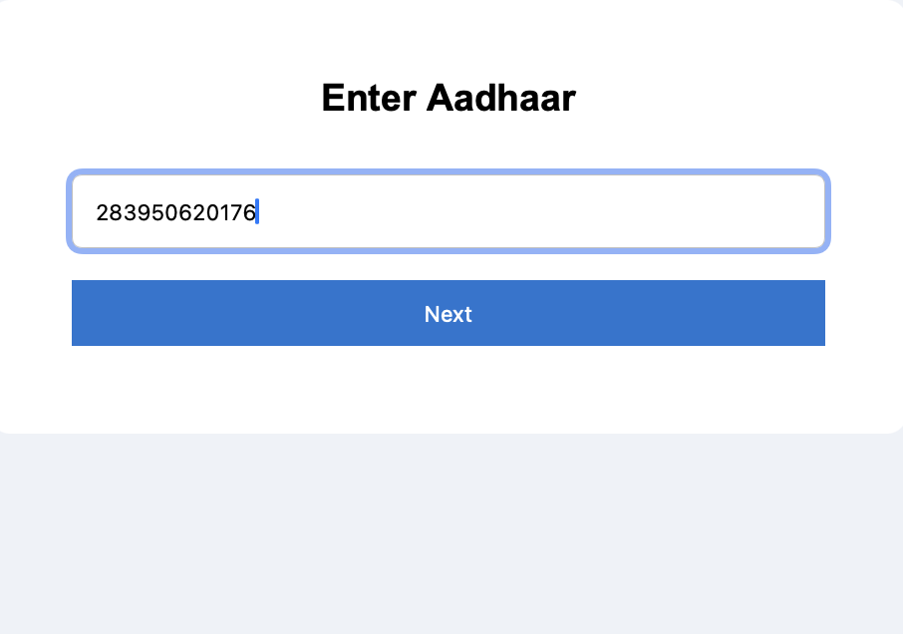
For Authentication

Slide 15
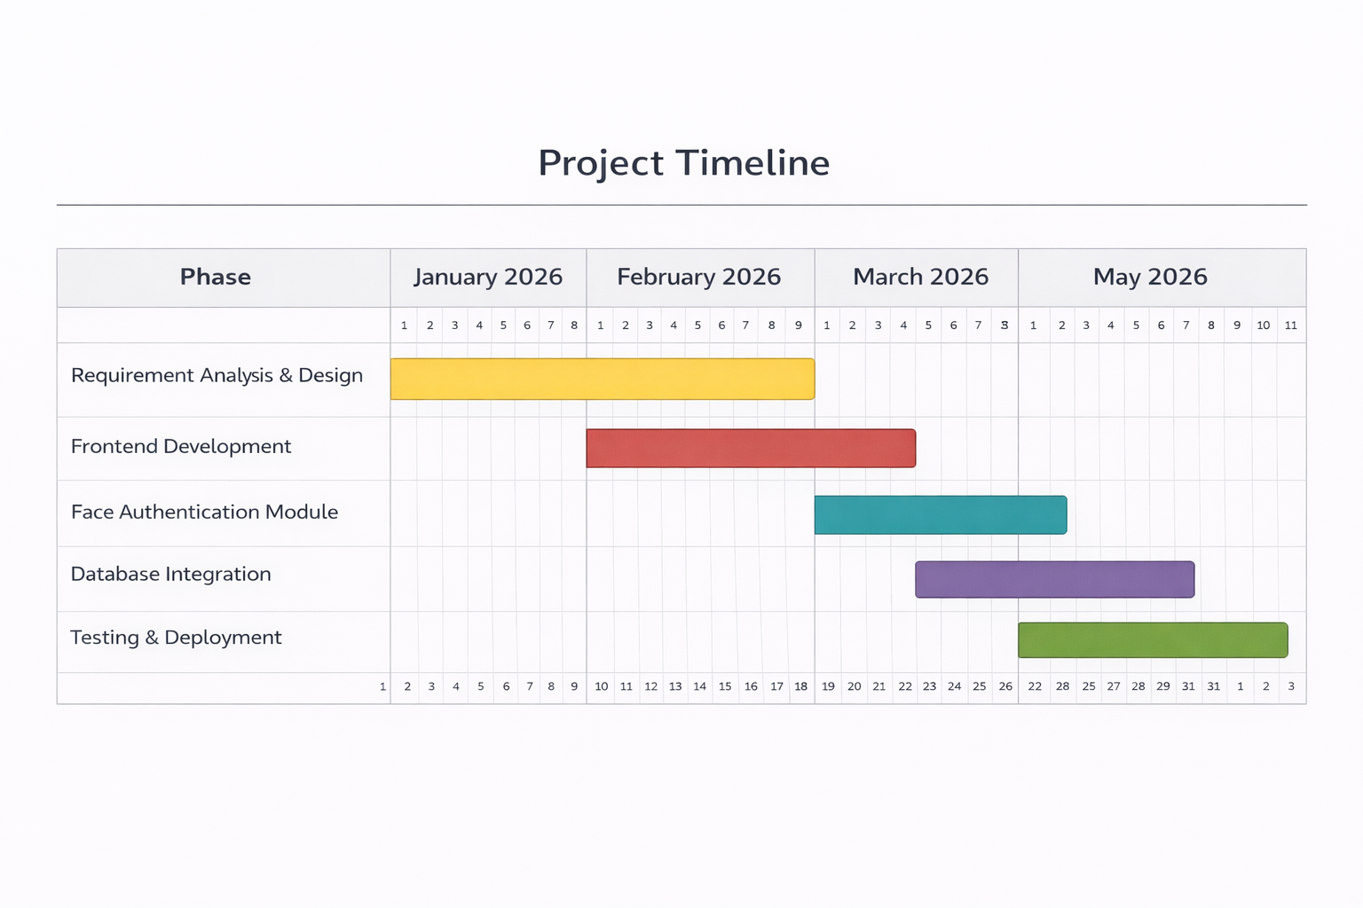
Project Timeline

Slide 16
References
R. L. Rivest and J. P. Wack, "On the Notion of ‘Software Independence’ in Voting Systems," National Institute of Standards and Technology (NIST), 2006.
D. Chaum, "Secret-Ballot Receipts: True Voter-Verifiable Elections," IEEE Security & Privacy, vol. 2, no. 1, pp. 38-47, 2004.
J. Benaloh, D. Byron, R. L. Rivest, P. Y. Ryan, P. Stark, V.
Teague, and P. Vora, "End-to-End Verifiable Elections,"
Communications of the ACM, vol. 58, no. 3, pp. 60-68, 2015.
T. Kohno, A. Stubblefield, A. D. Rubin, and D. S. Wallach, "Analysis of an Electronic Voting System," in Proceedings of the IEEE Symposium on Security and Privacy, pp. 27-40, 2004.
National Democratic Institute, "The Future of Online
Voting in Elections," 2022. [Online]. Available:
https://www.ndi.org/online-voting

Slide 17

THANK YOU

